Slide 1

IEEe 802.15.4
SEBIN JAMES 20-PDS-013

Slide 2

CONTENTS
What is IEEE 802.15.4 ?
History
Architecture
Network Topologies
Device types
Applications
Advantages and Disadvantages

Slide 3
What is Ieee 802.15.4 ?
IEEE stands for- Institute of Electrical and Electronic engineers, and it is a non profit organisation
IEEE sets standards for electrical and electronic equipment and the term standard here means they maintain the quality of those equipments
IEEE 802.15.4 is a technical standard which defines the operation of low-rate wireless personal area networks (LR-WPANs). It specifies the physical layer and media access control for LR-WPANs, and is maintained by the IEEE 802.15 working group, which defined the standard in 2003.

Slide 4



History of IEEE 802.15.4
PROJECT 802
Consider this laptop and computer and the 2 systems are having different architecture
If we want to connect them it was impossible in the beginning
In 1985 the computer society of IEEE started a project called as Project 802
This was to set standards and protocols to make intercommunication possible between systems which are different in their architecture

Slide 5
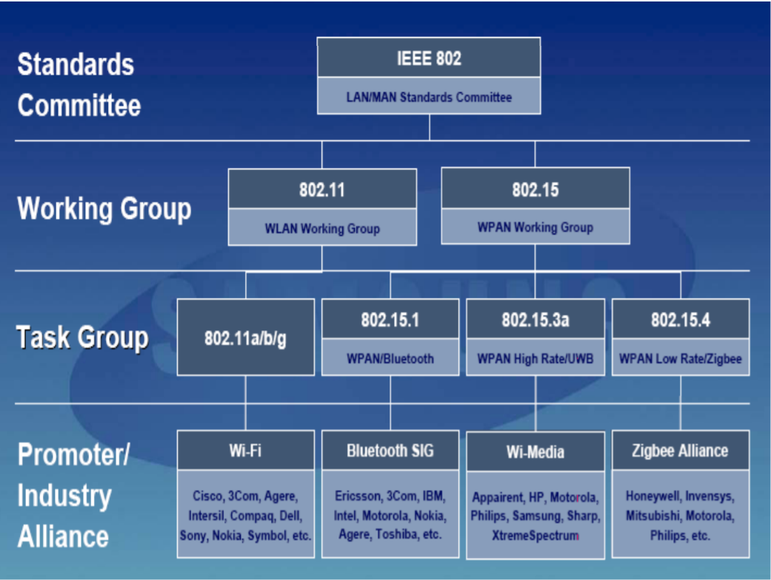

Slide 6
The first edition of the 802.15.4 standard was released in May 2003.
Several standardized and proprietary networks (or mesh) layer protocols run over 802.15.4-based networks, including IEEE 802.15.5, ZigBee, Thread, 6LoWPAN, WirelessHART, and ISA100.11a.
Apart from the original standard certain modification and amendments were made
WPAN Low Rate Alternative PHY (4a)
Revision and Enhancement 4(b)
PHY Amendment for China (4c)
PHY and MAC Amendment for Japan (4d)
MAC Amendment for Industrial Applications (4e)
MAC Amendment for Industrial Applications (4e)
PHY Amendment for Smart Utility Networks (4g)

Slide 7

Architecture of ieee 802.15.4

Slide 8
Architecture
Application
Presentation
Session
Transport
Network
Data link
Physical
Data Generation
Encryption and Formatting
OSI MODEL
Establishing Connections
Delivery and Sequencing
Routing to Destination
Local Network Host Delivery
Access to media

Slide 9
Other Layers
Other Layers
Network Layers
Network Layers
Data Link Layers
Physical Layer
OSI MODEL
LLC LAYER
MAC LAYER
Physical Layer

Slide 10

Logical Link Control Layer
LLC deals with flow control and error control
Its also called as Protocol Data Unit(PDU)
It Contains 4 fields: Destination Service Access Point (DSAP) , Source Service Access Point(SSAP) , Control Field And Information Field
Actual Address
0 = Individual
1 = Group
DSAP
Actual Address
0 = Command
1= Response
SSAP

Slide 11

Medium Access Control Layer (MAC)
Mainly used for allocating channels to host for the data transmission and take sit back when transmission is complete
There are different allocation and deallocation methods
Ethernet uses CSMA/CD
Token bus,Token ring LANs uses Token Passing
Channel

Slide 12
Architecture of ieee 802.15.4
Upper Layers
IEEE 802.2 LLC layer
Other LLC
IEEE 802.15.4 MAC layer
IEEE 802.15.4
868/915 MHz
PHY
IEEE 802.15.4
2400 MHz
PHY

Slide 13
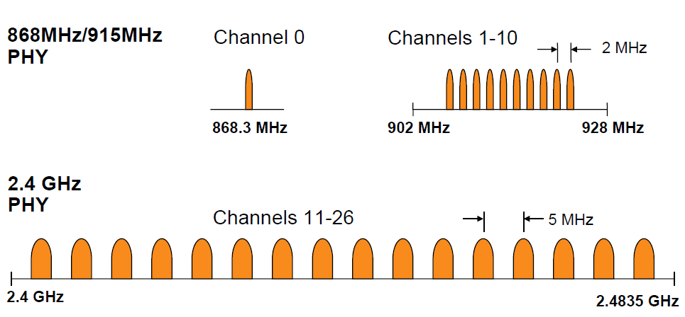
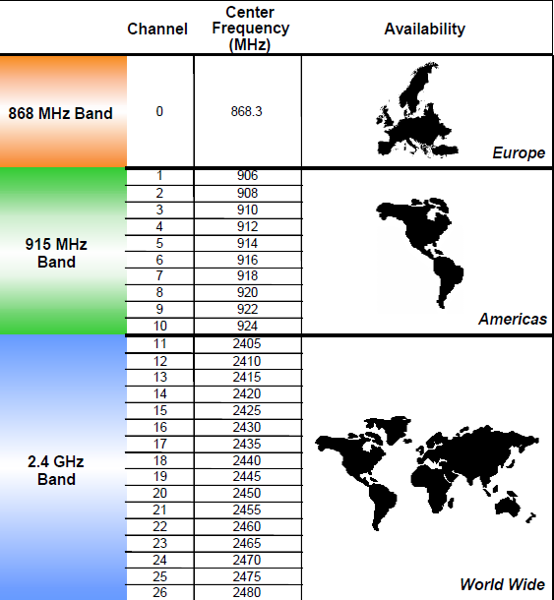
Features of Physical Layer of IEEE 802.15.4 model
The physical layer (PHY) provides the data transmission service
the PHY manages the physical radio transceiver, performs channel selection along with energy and signal management functions. It operates on one of three possible unlicensed frequency bands:
868.0–868.6 MHz: Europe, allows one communication channel (2003, 2006, 2011[5])
902–928 MHz: North America, up to ten channels (2003), extended to thirty (2006)
2400–2483.5 MHz: worldwide use, up to sixteen channels (2003, 2006)

Slide 14
Features of MAC layer in the IEEE 802.15.4 model
The medium access control (MAC) enables the transmission of MAC frames through the use of the physical channel
4 types of MAC frames :
Data Frame
Beacon Frame
Acknowledgement frame
MAC command frame
Contains information which is sent by the upper layers
Originate in the MAC and is mainly used for peer to peer communication

Slide 15
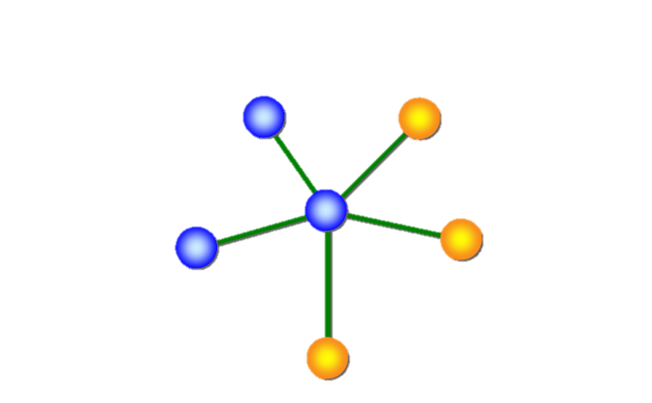
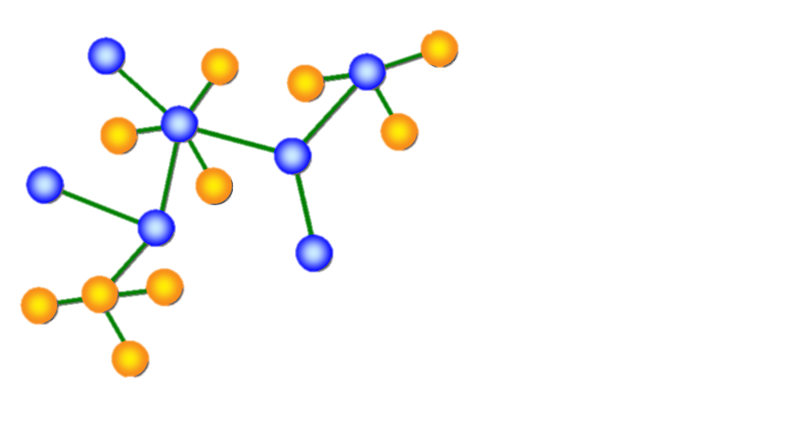
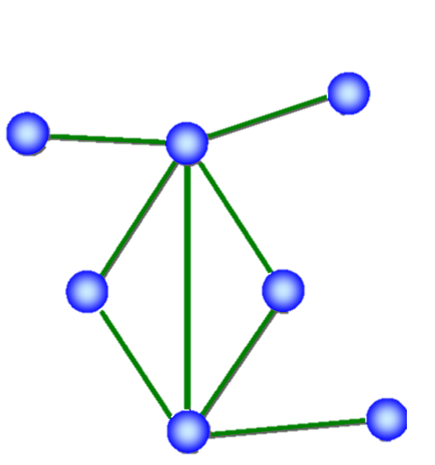
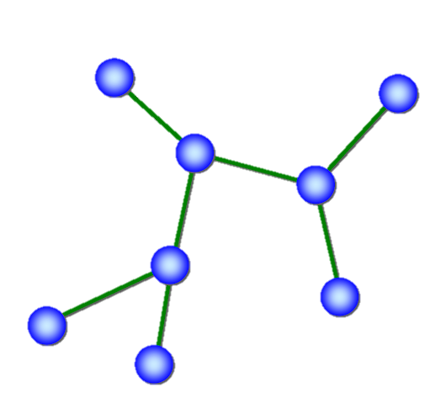
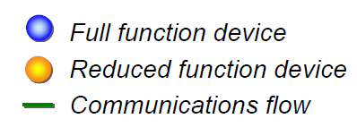
Network topologies
In order to create a network, an understanding of simple connection nodes and a basic structure is needed.
For LR-WPAN networks those nodes and structure is presented by the possible topologies. 802.15.4 protocol allows for the following network topologies:
Point to point
Cluster Tree
Clustered Stars
PAN coordinator
Star Topology
Peer to Peer Topology
Combined Topology

Slide 16
Types of devices in IEeE 802.15.4
There are two device classes that can participate in an 802.15.4 network :
Full Function Device (FFD)
Any topology
PAN coordinator capable
Talks to any other device
Implements complete protocol set
Reduced Function Device (RFD)
Limited to star topology or end-device in a peer-to-peer network.
Cannot become a PAN coordinator
Very simple implementation
Reduced protocol set

Slide 17
Definitions newly introduced in ieee 802.15.4
Network Device: An RFD or FFD implementation containing an IEEE 802.15.4 medium access control and physical interface to the wireless medium.
Coordinator: An FFD with network device functionality that provides coordination and other services to the network.
PAN Coordinator: A coordinator that is the principal controller of the PAN. A network has exactly one PAN coordinator.

Slide 18
Features of ieee 802.15.4
Data rates of 250 kbps, 40 kbps, and 20 kbps.
Two addressing modes; 16-bit short and 64-bit IEEE addressing.
Support for critical latency devices, such as joysticks.
CSMA-CA channel access.
Automatic network establishment by the coordinator.
Fully handshaked protocol for transfer reliability.
Power management to ensure low power consumption.
16 channels in the 2.4GHz ISM band, 10 channels in the 915MHz I and one channel in the 868MHz band.

Slide 19

Applications of ieee 802.15.4

Slide 20
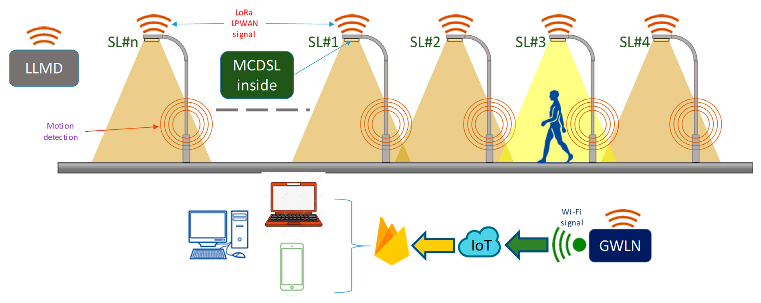

Motion Sensors that Control Lights or alarms

Slide 21

2. Wall Switches that can be moved at will

Slide 22
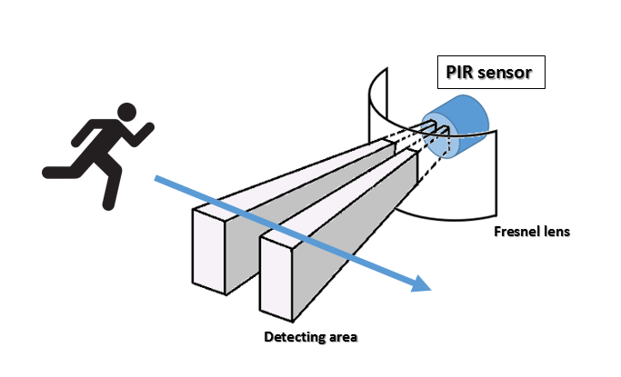

3. Passive Infrared Sensors for Building automation

Slide 23
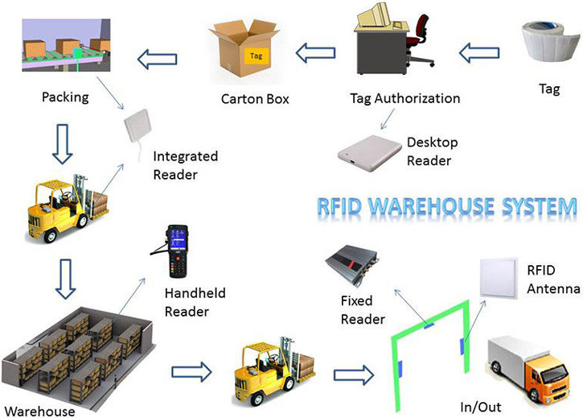
4. Asset and inventory tracking devices for use in retail stock rooms and warehouses

Slide 24
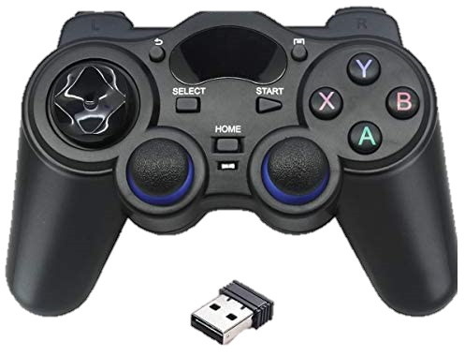
5. Game controllers for interactive toys

Slide 25
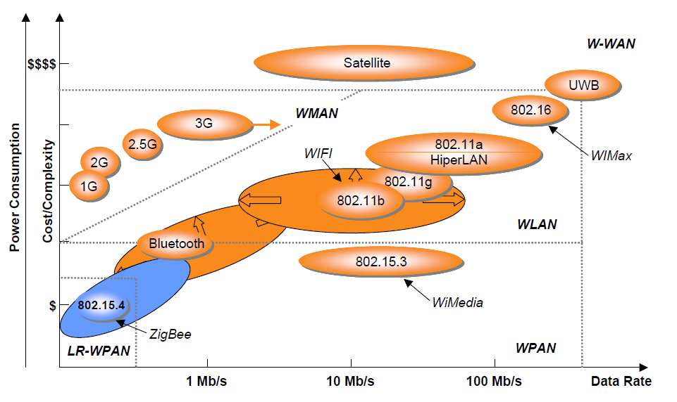
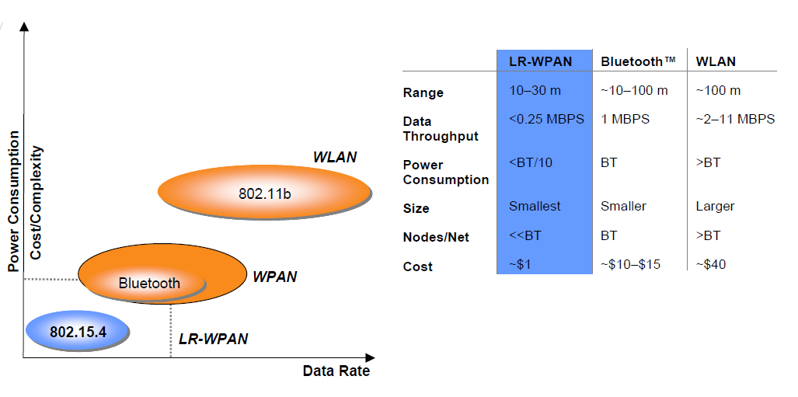
Advantages of ieee 802.15.4
Low Cost
Highly Reliable
Low power consumption
Ease of Implementation

Slide 26
Disadvantages of ieee 802.15.4
Security Risks
Energy Efficient Design
Synchronization
Transport Layer issue
Real time Communication

Slide 27
THANK YOU

